Slide 1

Course : Data Structures
Subject Code : CSEN2001 Program : B. Tech
Year : II
Dept. and Sec : CSE ( )
UNIT : V
Dr Kranthi Kumar Singamaneni
Dept. of C.S.E
G.S.T, GITAM Deemed to be University

Slide 2
Graphs: data structure for graphs
Properties of graphs, types of graphs,
Graph representations,
Graph traversals,
Directed acyclic graph,
Shortest path algorithms,
Spanning trees and min spanning tree.

Slide 3
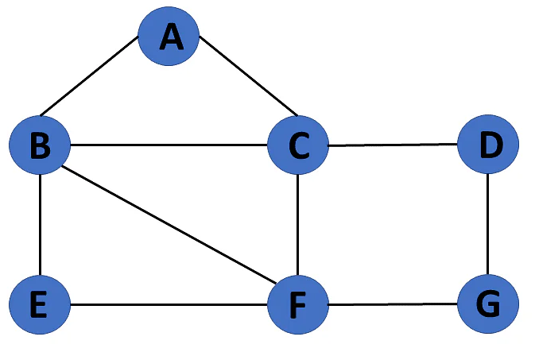
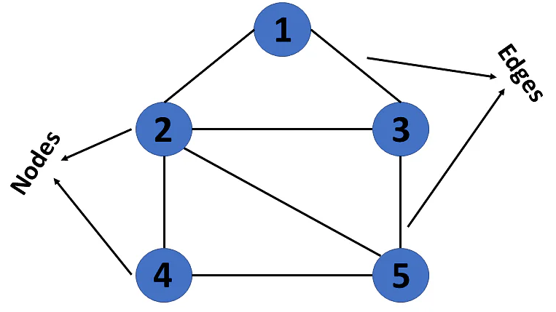
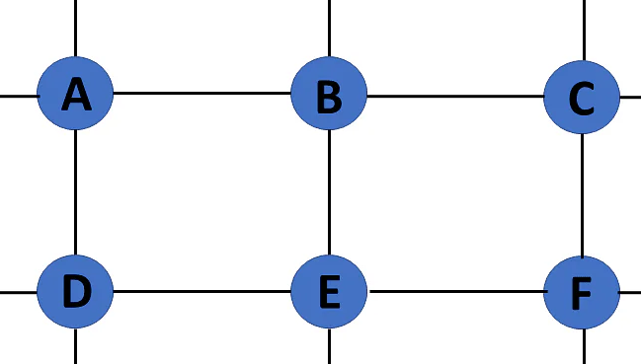
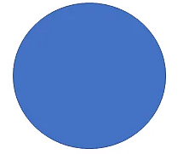
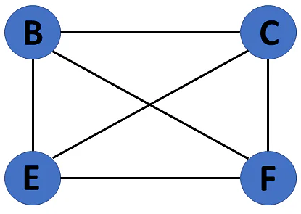
Types of Graphs in Data Structures: There are different types of graphs in data structures, each of which is detailed below.
1. Finite Graph: The graph G=(V, E) is called a finite graph if the number of vertices and edges in the graph is limited in the number.
2. Infinite Graph: The graph G=(V, E) is called a finite graph if the number of vertices and edges in the graph is interminable.
3. Trivial Graph: A graph G= (V, E) is trivial if it contains only a single vertex and no edges.
4. Simple Graph: If each pair of nodes or vertices in a graph G=(V, E) has only one edge, it is a simple graph.
As a result, there is just one edge linking two vertices, depicting one-to-one interactions between two elements.
Graphs in data structures are non-linear data structures made up of a finite number of nodes or vertices and the edges that connect them.
Graphs in data structures are used to address real-world problems in which it represents the problem area as a network like telephone networks, circuit networks, and social networks.
For example, it can represent a single user as nodes or vertices in a telephone network, while the link between them via telephone represents edges.
This graph has a set of vertices V= { 1,2,3,4,5} and a set of edges E= { (1,2),(1,3),(2,3),(2,4),(2,5),(3,5),(4,50 }.
Now that you’ve learned about the definition of graphs in data structures, you will learn about their various types.
What Are Graphs in Data Structure?
A graph is a non-linear kind of data structure made up of nodes or vertices and edges. The edges connect any two nodes in the graph, and the nodes are also known as vertices.

Slide 4
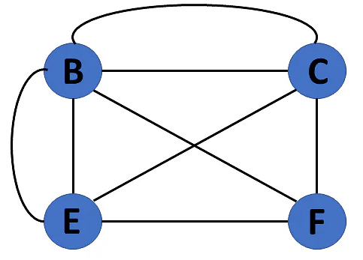
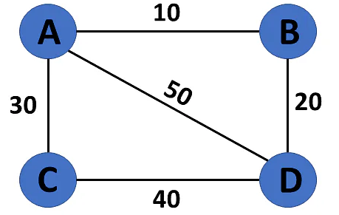
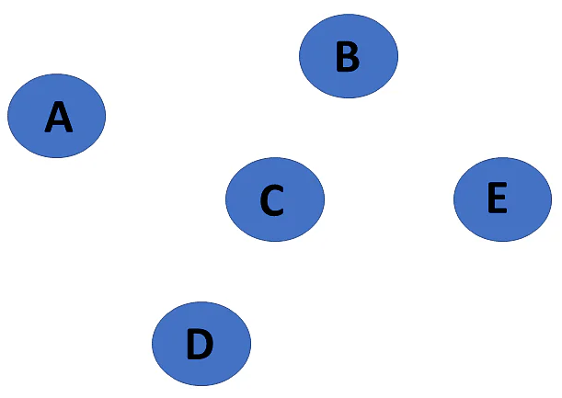
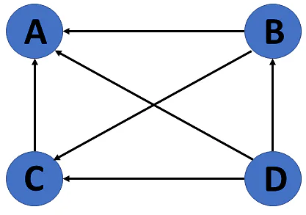
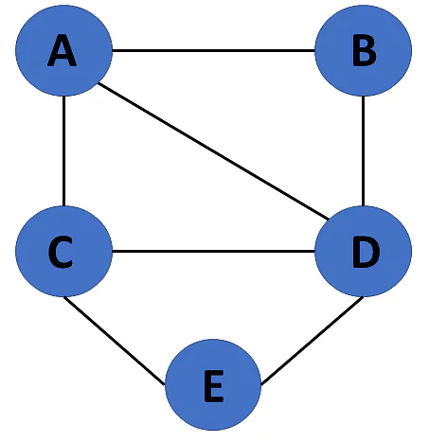
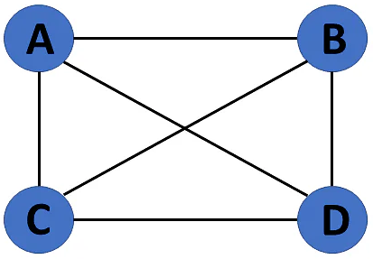
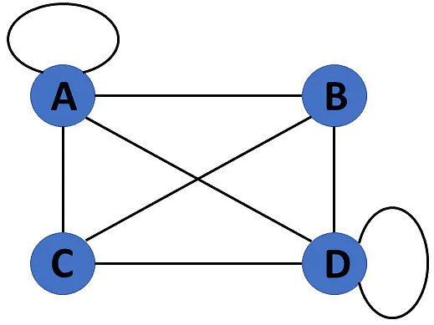
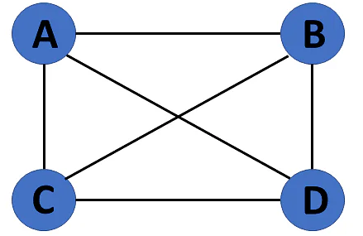
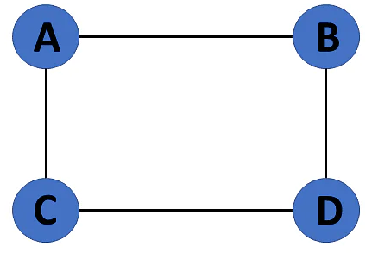
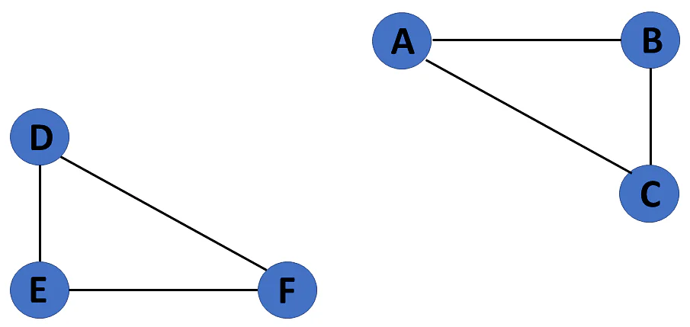
5. Multi Graph: The graph is referred to as a multigraph if there are numerous edges between a pair of vertices in a graph G= (V, E). There are no self-loops in a Multigraph.
6. Null Graph: It's a reworked version of a trivial graph. If several vertices but no edges connect them, a graph G= (V, E) is a null graph.
7. Complete Graph: If a graph G= (V, E) is also a simple graph, it is complete. Using the edges, with n number of vertices must be connected. It's also known as a full graph because each vertex's degree must be n-1.
8. Pseudo Graph: If a graph G= (V, E) contains a self-loop besides other edges, it is a pseudograph.
9. Regular Graph: If a graph G= (V, E) is a simple graph with the same degree at each vertex, it is a regular graph. As a result, every whole graph is a regular graph.
10. Weighted Graph: A graph G= (V, E) is called a labeled or weighted graph because each edge has a value or weight representing the cost of traversing that edge.
11. Directed Graph: A directed graph also referred to as a digraph, is a set of nodes connected by edges, each with a direction.
12. Undirected Graph: An undirected graph comprises a set of nodes and links connecting them. The order of the two connected vertices is irrelevant and has no direction. You can form an undirected graph with a finite number of vertices and edges.
13. Connected Graph: If there is a path between one vertex of a graph data structure and any other vertex, the graph is connected.
14. Disconnected Graph: When there is no edge linking the vertices, you refer to the null graph as a disconnected graph.

Slide 5
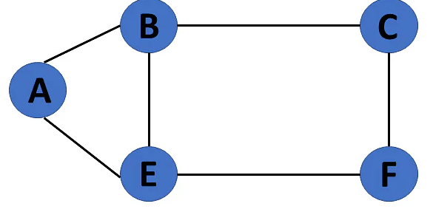
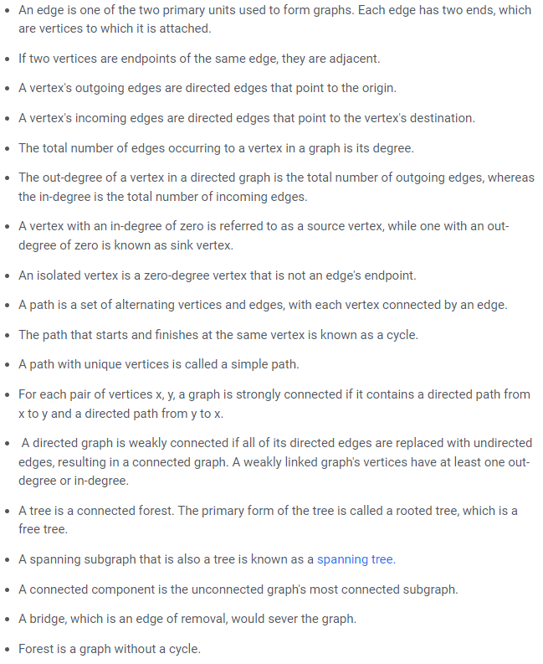
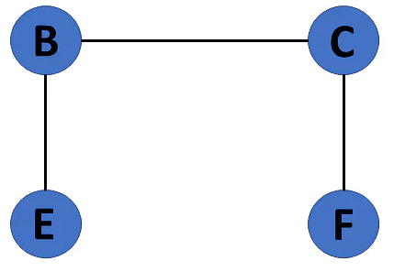
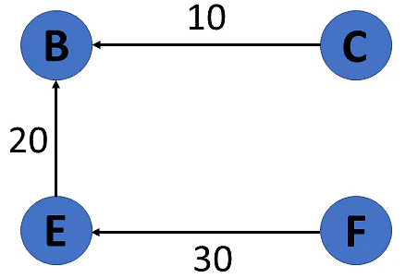
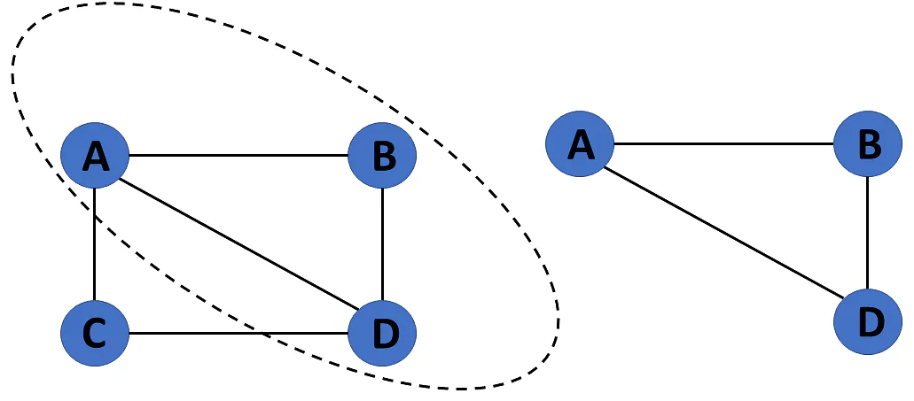
Terminologies of Graphs in Data Structures
15. Cyclic Graph: If a graph contains at least one graph cycle, it is considered to be cyclic.
16. Acyclic Graph: When there are no cycles in a graph, it is called an acyclic graph.
17. Directed Acyclic Graph: It's also known as a directed acyclic graph (DAG), and it's a graph with directed edges but no cycle. It represents the edges using an ordered pair of vertices since it directs the vertices and stores some data.
18. Subgraph: The vertices and edges of a graph that are subsets of another graph are known as a subgraph.

Slide 6
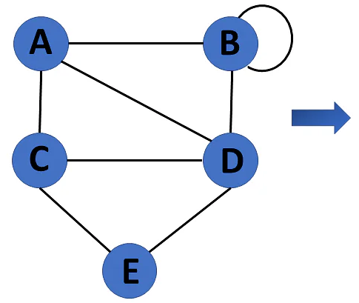
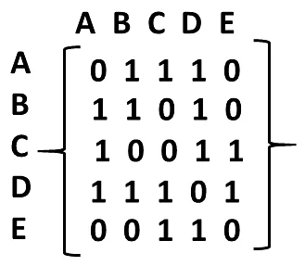
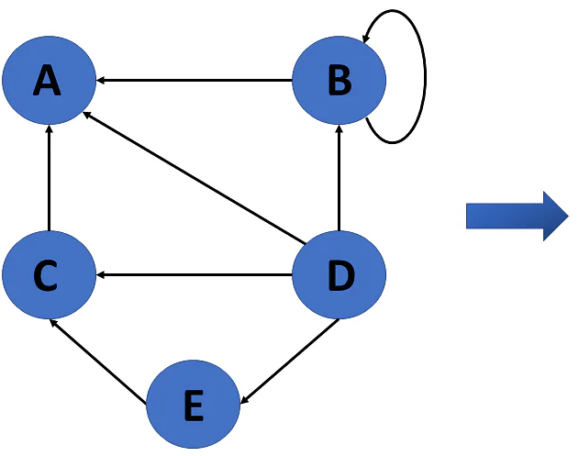
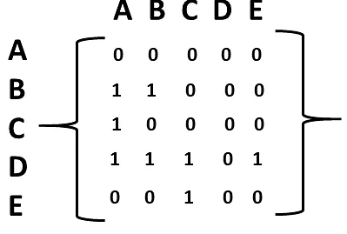
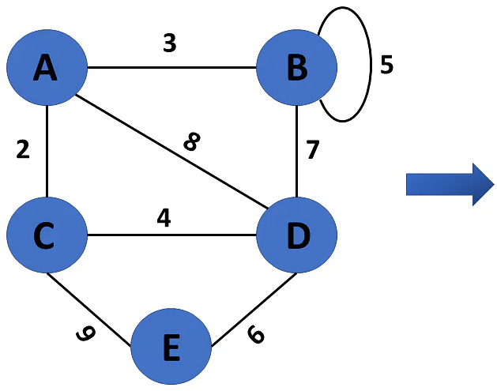
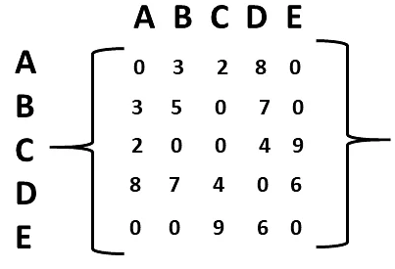
Representation of Graphs in Data Structures
Graphs in data structures are used to represent the relationships between objects. Every graph consists of a set of points known as vertices or nodes connected by lines known as edges. The vertices in a network represent entities.
The most frequent graph representations are the two that follow: → Adjacency matrix → Adjacency list
You’ll look at these two representations of graphs in data structures in more detail:
Adjacency Matrix: A sequential representation is an adjacency matrix. It's used to show which nodes are next to one another. I.e., is there any connection between nodes in a graph?
You create an M X M matrix G for this representation. If an edge exists between vertex a and vertex b, the corresponding element of G, gi,j = 1, otherwise gi,j = 0.
If there is a weighted graph, you can record the edge's weight instead of 1s and 0s.
Undirected Graph Representation
Directed Graph Representation
Weighted Undirected Graph Representation: Weight or cost is indicated at the graph's edge, a weighted graph representing these values in the matrix.

Slide 7
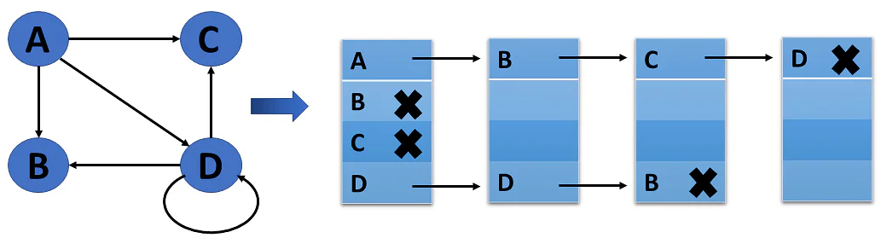
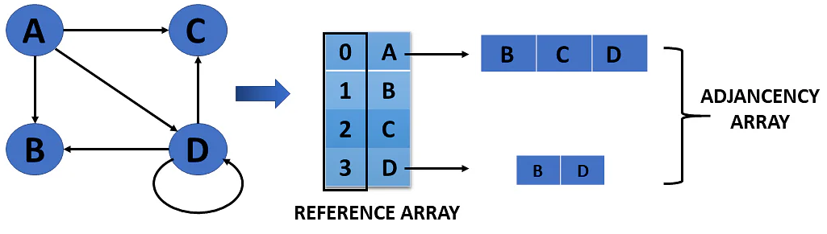
Adjacency List: A linked representation is an adjacency list.
You keep a list of neighbors for each vertex in the graph in this representation. It means that each vertex in the graph has a list of its neighboring vertices.
You have an array of vertices indexed by the vertex number, and the corresponding array member for each vertex x points to a singly linked list of x's neighbors.
Weighted Undirected Graph Representation Using Linked-List
Weighted Undirected Graph Representation Using an Array
Graph Traversal: In simple words, traversal means the process of visiting every node in the graph.
Graph traversal is a technique used for searching a vertex in a graph. The graph traversal is also used to decide the order of vertices is visited in the search process.
A graph traversal finds the edges to be used in the search process without creating loops. That means using graph traversal we visit all the vertices of the graph without getting into looping path.
There are two standard methods of graph traversal Breadth-First Search and Depth First Search
Breadth First Search: Breadth-First Search (BFS) is a graph traversal algorithm where we start from a selected(source) node and traverse the graph level by level, by exploring the neighbor nodes at each level.
Depth First Search: Depth First Search (DFS) is a graph traversal algorithm where we start from a selected(source) node and go into the depth of this node by recursively calling the DFS function until no children are encountered. When the dead-end is reached, this algorithm backtracks and starts visiting the other children of the current node.

Slide 8
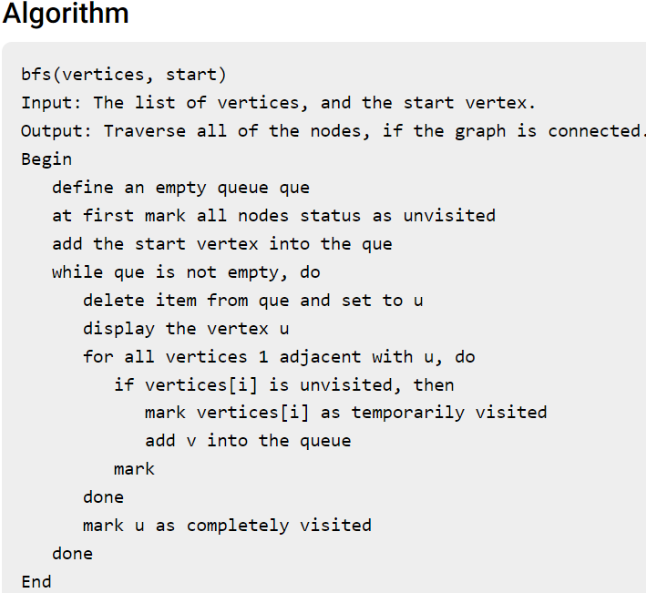
BFS (Breadth First Search): BFS traversal of a graph produces a spanning tree as the final result. A Spanning Tree is a graph without loops. We use a Queue data structure with a maximum size of the total number of vertices in the graph to implement BFS traversal. We use the following steps to implement BFS traversal…
Step 1 - Define a Queue of size and the total number of vertices in the graph.
Step 2 - Select any vertex as a starting point for traversal. Visit that vertex and insert it into the Queue.
Step 3 - Visit all the non-visited adjacent vertices of the vertex at the front of the Queue and insert them into the Queue.
Step 4 - When there is no new vertex to be visited from the vertex at the front of the Queue, then delete that vertex.
Step 5 - Repeat steps 3 and 4 until the queue becomes empty.
Step 6 - When the queue becomes empty, then produce the final spanning tree by removing unused edges from the graph

Slide 9
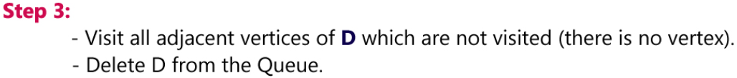
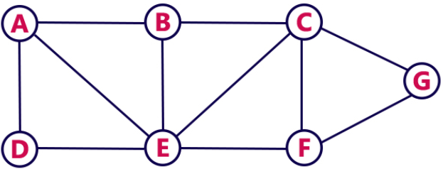
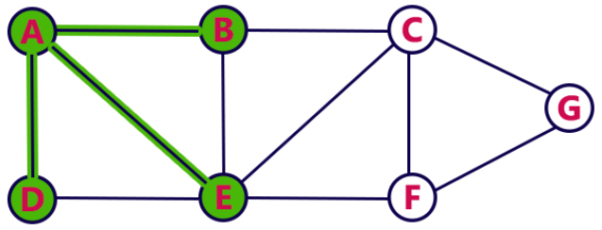
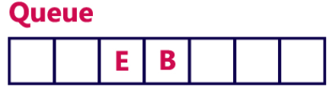
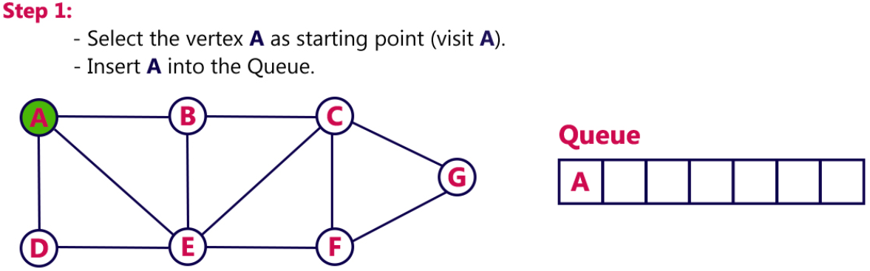
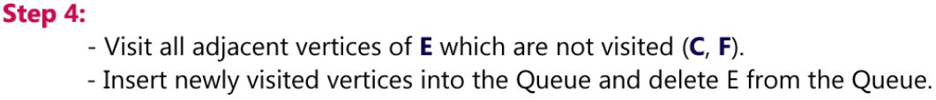
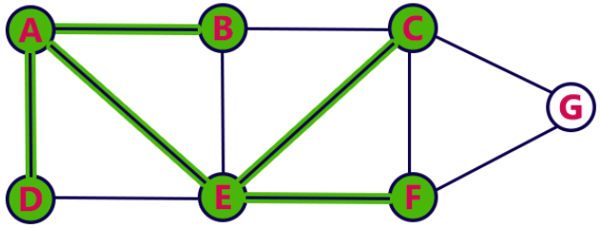
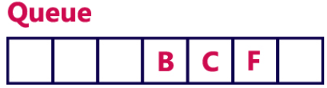
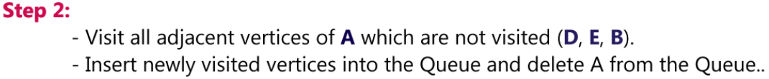
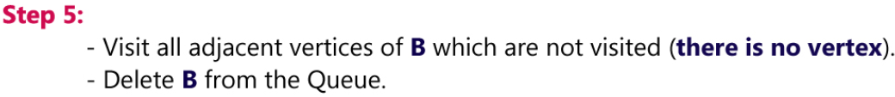
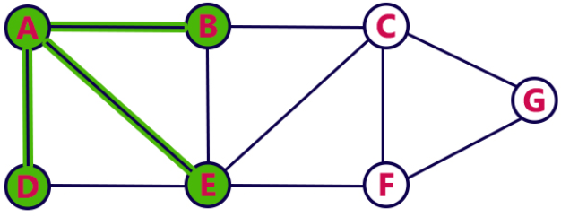
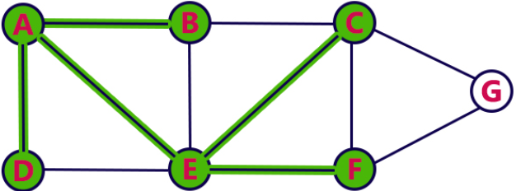
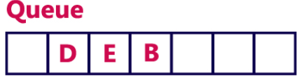
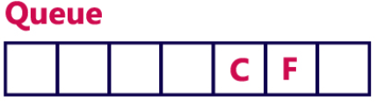

Slide 10
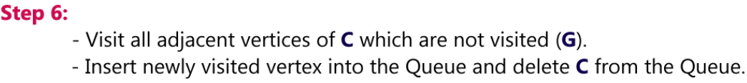
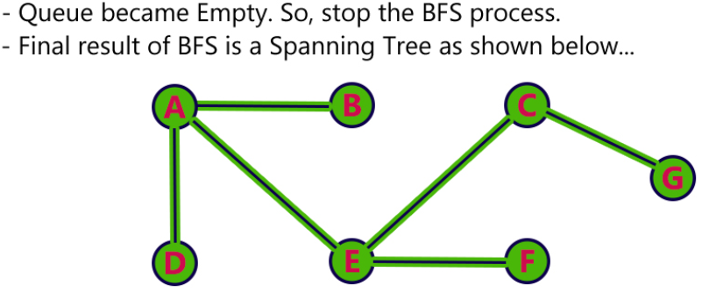
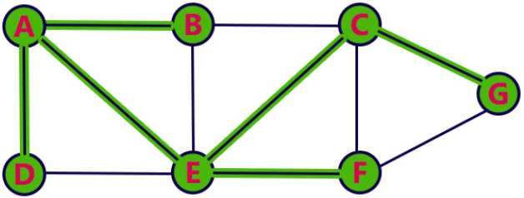
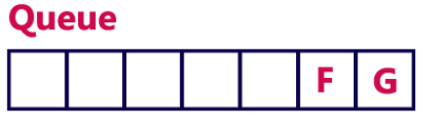
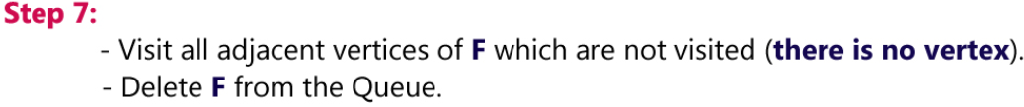
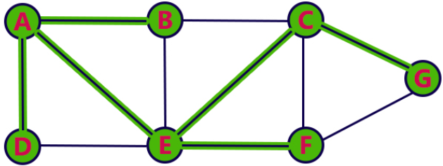
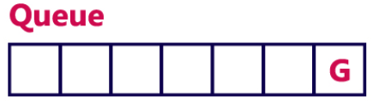




Slide 11





DFS (Depth First Search): DFS traversal of a graph produces a spanning tree as the final result.
A Spanning Tree is a graph without loops. We use a Stack data structure with a maximum size of a total number of vertices in the graph to implement DFS traversal. We use the following steps to implement DFS traversal…
Step 1 - Define a Stack of size total number of vertices in the graph.
Step 2 - Select any vertex as a starting point for traversal. Visit that vertex and push it onto the Stack.
Step 3 - Visit any one of the non-visited adjacent vertices of a vertex that is at the top of the stack and push it onto the stack.
Step 4 - Repeat step 3 until there is no new vertex to be visited from the vertex which is at the top of the stack.
Step 5 - When there is no new vertex to visit then, use backtracking and pop one vertex from the stack.
Step 6 - Repeat steps 3, 4, and 5 until the stack becomes Empty.
Step 7 - When the stack becomes Empty, then produce the final spanning tree by removing unused edges from the graph.

Slide 12













Slide 13













Slide 14

Directed Acyclic Graph (DAG)
Definition: In computer science and mathematics, a directed acyclic graph (DAG) refers to a directed graph which has no directed cycles.
Explanation: In graph theory, a graph refers to a set of vertices which are connected by lines called edges. In a directed graph or a digraph, each edge is associated with a direction from a start vertex to an end vertex. If we traverse along the direction of the edges and we find that no closed loops are formed along any path, we say that there are no directed cycles. The graph formed is a directed acyclic graph.
A DAG is always topologically ordered, i.e. for each edge in the graph, the start vertex of the edge occurs earlier in the sequence than the ending vertex of the edge.
Example
In the above directed graph, if we find the paths from any node, say u, we will never find a path that come back to u. Hence, this is a DAG.
Application Areas:
Some of the main application areas of DAG are −
Routing in computer networks
Job scheduling
Data processing
Citation graphs

Slide 15

Problem-01: Consider the following expression and construct a DAG for it- ( a + b ) x ( a + b + c )
Solution- Three Address Code for the given expression is-
T1 = a + b
T2 = T1 + c
T3 = T1 x T2
Now, Directed Acyclic Graph is-
NOTE
From the constructed DAG, we observe-
The common sub-expression (a+b) has been expressed into a single node in the DAG.
The computation is carried out only once and stored in the identifier T1 and reused later.
This illustrates how the construction scheme of a DAG identifies the common sub-expression and helps in eliminating its re-computation later.

Slide 16
Shortest Path Algorithms: The shortest path problem is about finding a path between 2 vertices in a graph such that the total sum of the edges weights is minimum. This problem could be solved easily using (BFS) if all edge weights were (1), but here weights can take any value. Three different algorithms are discussed below depending on the use-case.
Dijkstra's Algorithm
Bellman Ford's Algorithm
Floyd Warshall's Algorithm
Single-Source Shortest Path problem / dijkstra’s algorithm
Input: a weighted connected graph G=(V,E), and a nodes designated as a source node. The weights are represented by the 2D array (matrix) W[1:n,1:n], where W[i,j] is the weight of edge (i,j). If (i,j) is not an edge, W[i,j]=infinity Note: W[i.i]=0 for all i.
Problem: Find the distance between s and every node in the graph.
Let Y be a set, initially contain the single source node s.
Definition: A path from s to a node x outside Y is called special if every intermediary node on the path belongs to Y.
Let DIST[1:n] be a real array where
DIST[i]=the length of the shortest special path from s to i
Greedy selection policy: choose from all the nodes still outside Y the node of minimum DIST value, and add it to Y.
The claim, which will proved later, is that every node in Y has is DIST value equal to the distance from it to s.

Slide 17

The SSSP algorithm:
Procedure SSSP(in W[1:n,1:n], s; out DIST[1:n]);
begin
for i =1 to n do
DIST[i] := W[s,i];
endfor
/* implement Y is Boolean array Y[1:n] */
/* Y[i]= 1 if i belong to set Y, 0 otherwise */
Boolean Y[1:n]; /* initialized to 0*/
Y[s] := 1; /* add s to set Y */
for num =2 to n-1 do
choose a node u from out of Y such that
DIST[u] = min{DIST[i] | Y[i] = 0};
Y[u] := 1; /* Add u to Y;*/
/*update the DIST values of the other nodes*/
for all node w where Y[w] = 0 do
DIST[w]= min(DIST[w],DIST[u]+W[u,w]);
endfor
endfor
end
Time Complexity of the SSSP algorithm:
the 1st for-loop clearly takes O(n) time
Choosing u takes O(n) time, because it involves finding a minimum in an array.
The innermost for-loop for updating DIST has a constant-time body, and iterates at most n times, thus takes O(n) time.
Therefore, the for-loop iterating over num takes O(n*n) time thus, SSSp takes O(n^2) time.

Slide 18


What is a Minimum Spanning Tree?
A minimum spanning tree is a special kind of tree that minimizes the lengths (or “weights”) of the edges of the tree. An example is a cable company wanting to lay line to multiple neighborhoods; by minimizing the amount of cable laid, the cable company will save money.
A tree has one path joins any two vertices.
A spanning tree of a graph is a tree that contains all the original graph’s vertices. Reaches out to (spans) all vertices. It is acyclic. In other words, the graph doesn’t have any nodes which loop back to itself.

Slide 19

EXAMPLE
Relaxation:
If(d[u]+c(u,v)<d[v])
D[v]=d[u]+c(u,v)

Slide 20

Minimum cost spanning tree:

Slide 21

Finding Minimum Spanning Trees
As you can probably imagine, larger graphs have more nodes and many more possibilities for subgraphs. The number of subgraphs can quickly reach into the millions, or billions, making it very difficult (and sometimes impossible) to find the minimum spanning tree. Additionally, the lengths usually have different weights; one 5m long edge might be given a weight of 5, another of the same length might be given a weight of 7.
A few popular algorithms for finding this minimum distance include: Kruskal’s algorithm, Prim’s algorithm and Boruvka’s algorithm. These work for simple spanning trees. For more complex graphs, you’ll probably need to use software.

Slide 22


Finding Minimum Spanning Trees

Slide 23
Prim’s Algorithm | Kruskal’s Algorithm
It starts to build the Minimum Spanning Tree from any vertex in the graph. | It starts to build the Minimum Spanning Tree from the vertex carrying minimum weight in the graph.
It traverses one node more than one time to get the minimum distance. | It traverses one node only once.
Prim’s algorithm has a time complexity of O(V²), V being the number of vertices and can be improved up to O(E log V) using Fibonacci heaps. | Kruskal’s algorithm’s time complexity is O(E log V), V being the number of vertices.
Prim’s algorithm gives connected component as well as it works only on connected graph. | Kruskal’s algorithm can generate forest(disconnected components) at any instant as well as it can work on disconnected components
Prim’s algorithm runs faster in dense graphs. | Kruskal’s algorithm runs faster in sparse graphs.
It generates the minimum spanning tree starting from the root vertex. | It generates the minimum spanning tree starting from the least weighted edge.
Applications of prim’s algorithm are Travelling Salesman Problem, Network for roads and Rail tracks connecting all the cities etc. | Applications of Kruskal algorithm are LAN connection, TV Network etc.
Prim’s algorithm prefer list data structures. | Kruskal’s algorithm prefer heap data structures.

Slide 24
Minimum cost spanning tree:
Real Life Applications
Minimum spanning trees are used for network designs (i.e. telephone or cable networks). They are also used to find approximate solutions for complex mathematical problems like the Traveling Salesman Problem.
Other, diverse applications include:
Cluster Analysis.
Real-time face tracking and verification (i.e. locating human faces in a video stream).
Protocols in computer science to avoid network cycles.
Entropy based image registration.
Max bottleneck paths.
Dithering (adding white noise to a digital recording in order to reduce distortion).

Slide 25


Slide 26
Dynamic Programming: All pairs shortest path problem:
A weighted graph is a collection of points(vertices) connected by lines(edges), where each edge has a weight(some real number) associated with it. One of the most common examples of a graph in the real world is a road map. Each location is a vertex and each road connecting locations is an edge. We can think of the distance travelled on a road from one location to another as the weight of that edge.
Given a weighted graph, it is often of interest to know the shortest path from one vertex in the graph to another. The Floyd-Warshall algorithm determines the shortest path between all pairs of vertices in a graph. The shortest path in a weighted graph can be found by using the shortest path to the goal from all adjacent vertices. When the optimal solution to a problem can be constructed from optimal solutions to sub problems, using dynamic programming avoids re computing solutions that have already been computed.
The all-pairs shortest path problem can be considered the mother of all routing problems. It aims to compute the shortest path from each vertex v to every other u. Using standard single-source algorithms, you can expect to get a naive implementation of O(n³) if you use Dijkstra for example -- i.e. running a O(n²) process n times. Likewise, if you use the Bellman-Ford-Moore algorithm on a dense graph, it'll take about O(n⁴), but handle negative arc-lengths too.
Storing all the paths explicitly can be very memory expensive indeed, as you need one spanning tree for each vertex. This is often impractical in terms of memory consumption, so these are usually considered as all-pairs shortest distance problems, which aim to find just the distance from each to each node to another.
The result of this operation is an n * n matrix, which stores estimated distances to the each node. This has many problems when the matrix gets too big, as the algorithm will scale very poorly.

Slide 27

Dynamic Programming: All pairs shortest path problem:
The vertices in a graph be numbered from 1 to n. Consider the subset {1,2...,k} of these n vertices.
Imagine finding the shortest path from vertex i to vertex j that uses vertices in the set {1,2, ...,k} only. There are two situations:
In the first situation, we can break down our shortest path into two paths: i to k and then k to j. Note that all the intermediate vertices from i to k are from the set {1,2,...,k-1} and that all the intermediate vertices from k to j are from the set {1,2,...,k-1} also.
In the second situation, we simply have that all intermediate vertices are from the set {1,2,...,k-1}.

Slide 28
Dynamic Programming: All pairs shortest path problem:
Problem description
When a weighted graph, represented by its weight matrix W then objective is to find the distance between every pair of nodes. We will apply dynamic programming to solve the all pairs shortest path
Step 1:
We will decompose the given problem into sub problems. Let, Ak(i,j) be the length of shortest path from node i to node j such that the label for every intermediate node will be <=k.We will compute Ak for k=1……..n for n nodes.
Step 2:
For solving all pair shortest path the principle of optimality is used that means any sub path of shortest path is a shortest path between the end nodes. Divide the paths from path from i node to j node for every intermediate node say k then there arises two cases.
i)Path going from i to j via k.
ii)Path which is not going via k.
Select only shortest path from two cases.

Slide 29
Dynamic Programming: All pairs shortest path problem:
Step 3: The shortest path can be composed using bottom up computation method. Now, define the function A for a weighted graph with the vertices {1,2,...n} as follows:
A^{k}(i,j) = the shortest distance from vertex i to vertex j using the intermediate vertices in the set {1,2,...,k}.
Now, using the ideas from above, we can actually recursively define the function A:
A^{k} (i,j) = w(i,j), if k=0
= min( A^{k-1}(i,j), A^{k-1}(i,k)+A^{k-1}(k,j) ) if k > 0
In English, the first line says that if we do not allow intermediate vertices, then the shortest path between two vertices is the weight of the edge that connects them. If no such weight exists, we usually define this shortest path to be of length infinity.
1) k is an intermediate vertex on the shortest path. 2) k is not an intermediate vertex on the shortest path.
The second line pertains to allowing intermediate vertices. It says that the minimum path from i to j through vertices {1,2,...,k} is either the minimum path from i to j through
vertices {1,2,...,k-1} OR the sum of the minimum path from vertex i to k through {1,2,...,k-1} plus the minimum path from vertex k to j through {1,2,...k-1}. Since this is the case, we compute both and choose the smaller of these.
All of this points to storing a 2-dimensional table of shortest distances and using dynamic programming for a solution.

Slide 30
Dynamic Programming: All pairs shortest path problem:
Floyd's Algorithm
Input: A weighted graph, represented by its weight matrix W.
Problem: find the distance between every pair of nodes.
Dynamic programming Design:
Notation: A^{(k)}(i,j) = length of the shortest path from node i to node j where the label of every intermediary node is <= k.
A⁽⁰⁾(i,j) = W[i,j].
Principle of Optimality: We already saw that any sub-path of a shortest path is a shortest path between its end nodes.
recurrence relation:
Divide the paths from i to j where every intermediary node is of label <=k into two groups:
Those paths that do go through node k
Those paths that do not go through node k.
the shortest path in the first group is the shortest path from i to j where the label of every intermediary node is <= k-1.
therefore, the length of the shortest path of group 1 is A^{(k-1)}(i,j)
Each path in group two consists of two portions: The first is from node i to node k, and the second is from node k to node j.

Slide 31
Dynamic Programming: All pairs shortest path problem:
the shortest path in group 2 does not goe through K more than once, for otherwise, the cycle around K can be eliminated, leading to a shorter path in group 2.
Therefore, the two portions of the shortest path in group 2 have their intermediary labels <= k-1.
Each portion must be the shortest of its kind. That is, the portion from i to k where intermediary node is <= k-1 must be the shortest such a path from i to k. If not, we would get a shorter path in group 2. Same thing with the second portion (from j to k).
Therefore, the length of the first portion of the shortest path in group 2 is A^{(k-1)}(i,k)
Therefore, the length of the 2nd portion of the shortest path in group 2 is A^{(k-1)}(k,j)
Hence, the length of the shortest path in group 2 is A^{(k-1)}(i,k) + A^{(k-1)}(k,j)
Since the shortest path in the two groups is the shorter of the shortest paths of the two groups, we get
A^{(k)}(i,j)=min(A^{(k-1)}(i,j), A^{(k-1)}(i,k) + A^{(k-1)}(k,j)).

Slide 32
Dynamic Programming: All pairs shortest path problem:
The algorithm follows:
Procedure APSP(input: W[1:n,1:n];A[1:n,1:n])
1. begin
2. for i=1 to n do
3. for j=1 to n do
4. A(0)(i,j) := W[i,j];
5. endfor
6. endfor
7. for k=1 to n do
8. for i=1 to n do
9. for j=1 to n do
10. A(k)(i,j)=min(A(k-1)(i,j),A(k-1)(i,k) + A(k-1)(k,j))
11. endfor
12. endfor
13. endfor
14. end
•Note that once A(k) has been computed, there is no need for A(k-1)
•Therefore, we don't need to keep the superscript
•By dropping it, the algorithm remains correct, and we save on space
the new implementation follows:
Time Complexity Analysis:
•The first double for-loop takes O(n2) time.
•The triple for-loop that follows has a constant-time body, and thus takes O(n3) time.
•Thus, the whole algorithm takes O(n3) time.

Slide 33


Dynamic Programming: All pairs shortest path problem:
Here is the basic idea: Set up a 2D array that stores all the weights between one vertex and another. Here is an example:
A^{(k)}(i,j)=min{(A^{(k-1)}(i,j),A^{(k-1)}(i,k) + A^{(k-1)}(k,j))} k≥1
For k=1
A¹(1,1)=min{A⁰(1,1),A⁰(1,1) + A⁰(1,1)} =min{0,0+0}=0
A¹(1,2)=min{A⁰(1,2),A⁰(1,1) + A⁰(1,2)} =min{4,0+4}=4
A¹(1,3)=min{A⁰(1,3),A⁰(1,1) + A⁰(1,3)} =min{15,0+15}=15
A¹(2,1)=min{A⁰(2,1),A⁰(2,1) + A⁰(1,1)} =min{8,8+0}=8
A¹(2,2)=min{A⁰(2,2),A⁰(2,1) + A⁰(1,2)} =min{0,8+4}=0
A¹(2,3)=min{A⁰(2,3),A⁰(2,1) + A⁰(1,3)} =min{2,8+15}=2
A¹(3,1)=min{A⁰(3,1),A⁰(3,1) + A⁰(1,1)} =min{3,3+0}=3
A¹(3,2)=min{A⁰(3,2),A⁰(3,1) + A⁰(1,2)} =min{∞,3+4}=7
A¹(3,3)=min{A⁰(3,3),A⁰(3,1) + A⁰(1,3)} =min{0,3+15}=0

Slide 34

Dynamic Programming: All pairs shortest path problem:
Here is the basic idea: Set up a 2D array that stores all the weights between one vertex and another. Here is an example:
For k=2
A²(1,1)=min{A¹(1,1),A¹(1,2) + A¹(2,1)} =min{0,4+15}=0
A²(1,2)=min{A¹(1,2),A¹(1,2) + A¹(2,2)} =min{4,4+0}=4
A²(1,3)=min{A¹(1,3),A¹(1,2) + A¹(2,3)} =min{15,4+2}=6
A²(2,1)=min{A¹(2,1),A¹(2,2) + A¹(2,1)} =min{8,0+8}=8
A²(2,2)=min{A¹(2,2),A¹(2,2) + A¹(2,2)} =min{0,0+0}=0
A²(2,3)=min{A¹(2,3),A¹(2,2) + A⁰(2,3)} =min{2,0+2}=2
A²(3,1)=min{A¹(3,1),A¹(3,2) + A⁰(2,2)} =min{3,7+0}=3
A²(3,2)=min{A¹(3,2),A¹(3,2) + A⁰(2,2)} =min{7,7+0}=7
A²(3,3)=min{A¹(3,3),A¹(3,2) + A¹(2,3)} =min{0,7+2}=0

Slide 35


Dynamic Programming: All pairs shortest path problem:
Here is the basic idea: Set up a 2D array that stores all the weights between one vertex and another. Here is an example:
For k=3
A³(1,1)=min{A²(1,1),A²(1,3) + A²(3,1)} =min{0,6+3}=0
A³(1,2)=min{A²(1,2),A²(1,3) + A²(3,2)} =min{4,6+7}=4
A³(1,3)=min{A²(1,3),A²(1,3) + A²(3,3)} =min{6,6+0}=6
A³(2,1)=min{A²(2,1),A²(2,3) + A¹(3,1)} =min{8,2+3}=5
A³(2,2)=min{A²(2,2),A²(2,3) + A²(3,2)} =min{0,2+7}=0
A³(2,3)=min{A²(2,3),A²(2,3) + A²(3,3)} =min{2,2+0}=2
A³(3,1)=min{A²(3,1),A²(3,3) + A²(3,1)} =min{3,0+3}=3
A³(3,2)=min{A²(3,2),A²(3,3) + A²(3,2)} =min{7,0+7}=7
A³(3,3)=min{A²(3,3),A²(3,3) + A²(3,3)} =min{0,0+0}=0

